Slide 1




Frontend Class - 1

Slide 2


What’s in it?
Notes:
Gentle introduction to …

Slide 3
Rules of the house …
We start right on time … so please be on time
You are expected to do small exercises

Slide 5
Hyper Text Markup Language
A language that tells the browser
how to structure a webpage

Slide 6

HTML Syntax
Elements
<p>Hello Better World</p>
Open tag
Content
Close tag
Attributes
<img src=“https://...” >
Attribute
Value
Relationships
Parent
<div>
<h1>Hello Better World</h1>
<h2>Hello Better World</h2>
</div>
Child
Siblings

Slide 7
HTML 5 - structure
<!DOCTYPE HTML>
<html> <head> <meta charset="UTF-8”> ... </head> <body> ... Content ...
</body> </html>

Slide 8
HTML 5 - structure
<!DOCTYPE HTML>
<html> <head>
... </head> <body> ... Content ...
</body> </html>

Slide 9
HTML 5 - structure
<!DOCTYPE HTML>
<html> <head> <title>Demo</title>
... </head> <body> ... Content ...
</body> </html>

Slide 10
HTML tags (subset)
<div> <span> <p>
<a>
<h1> … <h6>
<img> <video> <audio>
<b> <i> <u> <em> <strike>
<form> <input type=“…”>
<br> <hr>
<table> <th> <tr> <td>
<ul> <ol> <li>

Slide 11

Let’s code
https://codepen.io/wvegteren/pen/oNvovbV?editors=1000

Slide 12
Semantic HTML
HTML that introduces meaning to the web page
rather than just presentation
Notes:
<p> tag indicates that the enclosed text is a paragraph.
This is both semantic and presentational because people know what paragraphs are and browsers know how to display them
tags like <b> and <i> are not semantic, because they define only how the text should look (bold or italic) and do not provide any additional meaning to the markup.

Slide 13
Semantic HTML
Why should we care?
Readability → Maintainability
Makes clear to the browser the meaning of a page and its content
Search engines
Accessibility → screen readers, etc.
Gives many hooks for content styling

Slide 14
Semantic HTML
<header>
<header>
<footer>
<nav>
<section>
<article>
<aside>
<nav>
<section>
<aside>
<article>
<article>
<article>
<section>
<section>
<footer>
Notes:
And more like <p> <figure>. <blockquote> <abbr> …

Slide 15
Mobile Friendly?

Slide 16
Mobile Friendly
Make full use of the device display
<!DOCTYPE HTML> <html> <head>
<meta name="viewport” content="width=device-width, initial-scale=1.0">
</head>
...

Slide 17
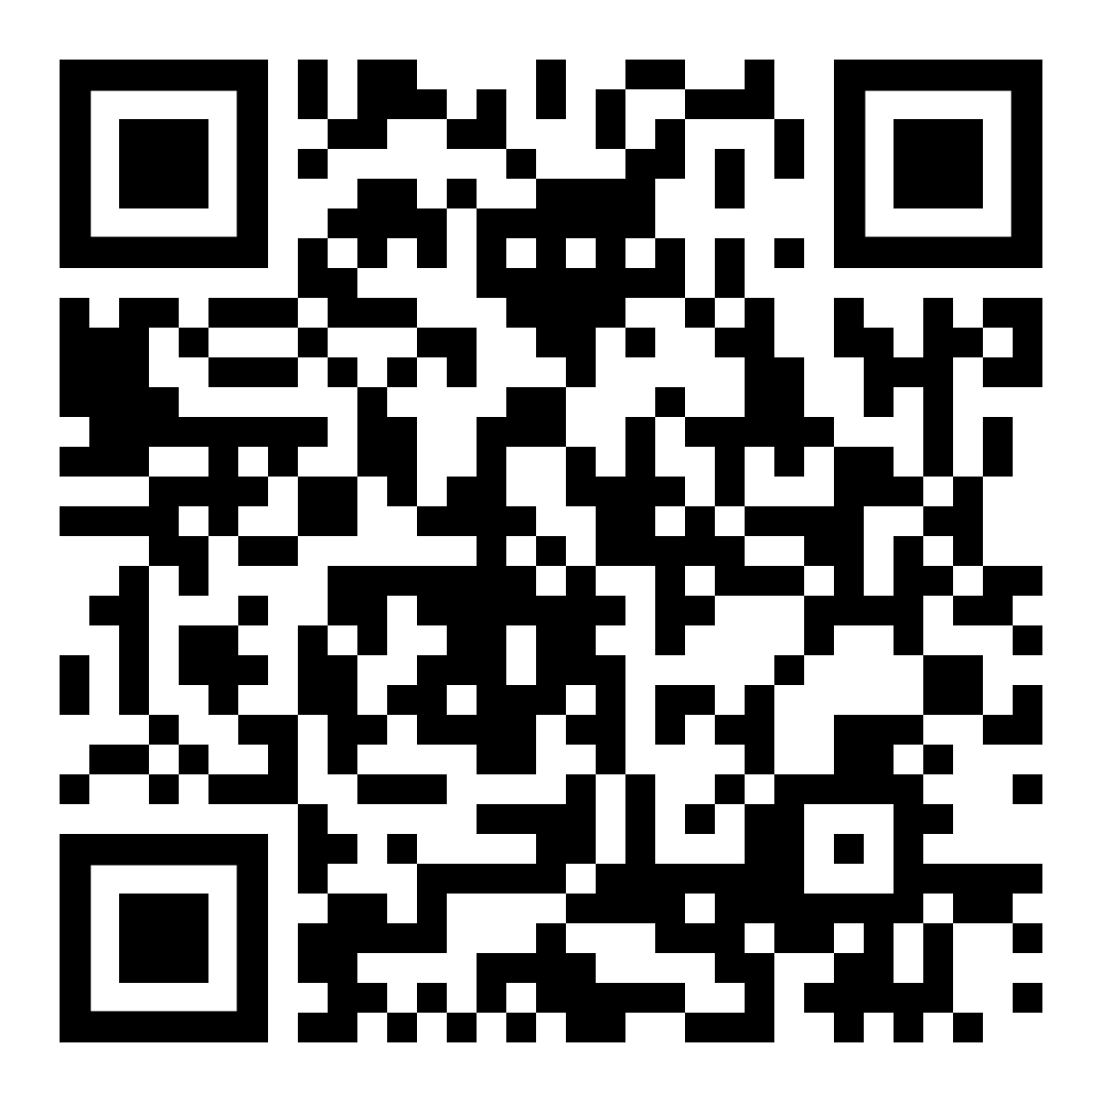
Mobile Friendly
Show appropriate keyboard
<input type=“text”>
<input type=“number”>
<input type=“tel”>
<input type=“email”>
<input type=“url”>
<input type=“color”>
<input type=“date”>
…
https://codepen.io/wvegteren/pen/eYOGBzj

Slide 18
Security

Slide 19
Security
Subresource Integrity
<link rel="stylesheet”
href="https://bootstrapcdn.com/.../bootstrap.min.css">
vs
<link rel="stylesheet”
href="https://bootstrapcdn.com/.../bootstrap.min.css" integrity="sha384-ggOyR0iXCbMQv3Xipma34MD+dH/1fQ784/
j6cY/iJTQUOhcWr7x9JvoRxT2MZw1T" crossorigin="anonymous">
Notes:
Content-Security-Policy header

Slide 20
Can I use … ?
https://caniuse.com/

Slide 21
Accessibility

Slide 22
Accessibility
Types of disabilities:
Visual impairments
Deafness / hard of hearing
Motor disabilities
Cognitive disabilities

Slide 23
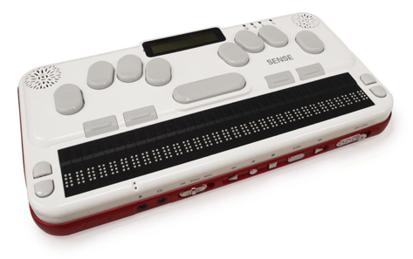
Accessibility
Visual impairments
No / low vision
Color blindness
Assistive technology
Text zoom software
Screen reader
Braille reader

Slide 24
Accessibility
Deafness / hard of hearing
Assistive technology
Hearing aid
Captions/audio descriptions
Transcripts

Slide 25
Accessibility
Motor disabilities, challenges:
Using a mouse
Interacting with small UI elements
Being accurate with interactions
Assistive technology
Keyboard
Voice dictation software
Wand mouth stick

Slide 26
Accessibility
Cognitive disabilities, challenges:
Dyslexia
Learning disabilities
Assistive technology
“Reader mode” to remove distractions
“Reduce motion” operating system feature (Enable Media Query to ie. prevent flickering, remove annimations)

Slide 27
Accessibility

Slide 28
Accessibility
WCAG Levels:
Level A Provides a baseline to meet basic usability needs of most people
Level AA Includes usability which meets the needs of most people with disabilities
Level AAA Success criteria to meet the needs of all people and beyond

Slide 29
Accessibility
Semantic HTML is the foundation
of an accessible web page
Semantics include:
Accessible name
Element role
Current state
Notes:
Landmark elements like Hearde, Footer, Nav …

Slide 30
Accessibility
The accessible name / label / text

Slide 31
Accessibility
The element role

Slide 32
Accessibility
The current state

Slide 33
Accessibility
The page title is first announced by a screen reader
and should describe the topic or purpose
Think about
Multi step forms
Errors in form
…

Slide 34
Accessibility
People who depend on assistive technology
often navigate by headings first
<h1>Primary heading</h1> <!-- … --> <h2>Sub-section</h2> <!-- … --> <h3>Sub-sub-section</h3> <!-- … --> <h2>Sub-section</h2> <!-- … -->
Logical heading order is key
Notes:
Multi step forms, errors in form, etc.

Slide 35
Accessibility
Images must have alt attribute
Alt text:
should be accurate and descriptive ... but not overwhelming
Is shown when a image fails to load
Helps SEO
Notes:
If no alt text …
Invalid HTML
Img SRC is announced
SEO, and shown when the image fails to load

Slide 36
Accessibility
<a> vs <button>
<a> | <button>
Loading a new page Downloading a file Jumping to a section on the same page | Submitting a form Executing an on-screen action ie. sorting table columns
Shift focus
No focus shift
Notes:
Expected behaviour

Slide 37
Accessibility
Forms
Use <fieldset> to group inputs
Use <label>
Associated with its input
Always visible
Don’t use placeholder attribute on <input>
Error messages preferred below the input
Notes:
Placeholder 👎
Text is removed from view when typing
May look like text has been entered

Slide 38
Accessibility
Accessible Rich Internet Applications - ARIA
ARIA can provide:
Accessible name
Element role
Current state
https://www.w3.org/TR/wai-aria-1.1/
Notes:
Custom components
What ARIA does not do
Does not make elements keyboard focusable
Does not automatically provide keyboard support

Slide 39
Accessibility
ARIA examples
<div role="button" aria-label="Fake button" aria-disabled="true"></div>
<div class="..."> <div class="..." role="checkbox" aria-checked="false" aria-labelledby="fake-checkbox"></div> <div class="..." id="fake-checkbox">Fake checkbox</div> </div>
Notes:
Custom components

Slide 40
Accessibility
Check your pages !
Validators for Chrome, Firefox, …

Slide 41
Accessibility

Slide 42
Questions ?

